Slide 1
ZOMATO RESTAURANT ANALYSIS
BY:- SANDESH MORE

Slide 2

INTRODUCTION
In the ever-evolving landscape of the food industry, Zomato stands as a pioneering force, revolutionizing how people discover, order, and experience culinary delights. With a relentless commitment to innovation and customer satisfaction, Zomato is embarking on an ambitious journey of expansion, seeking to open newer restaurants in strategic locations around the globe.

Slide 3
OBJECTIVE
Market Insights
01
Operational Efficiency
04
Strategic Location Selection
02
Customer Engagement
05
Concept Development
03
06
Marketing and Promotion

Slide 4
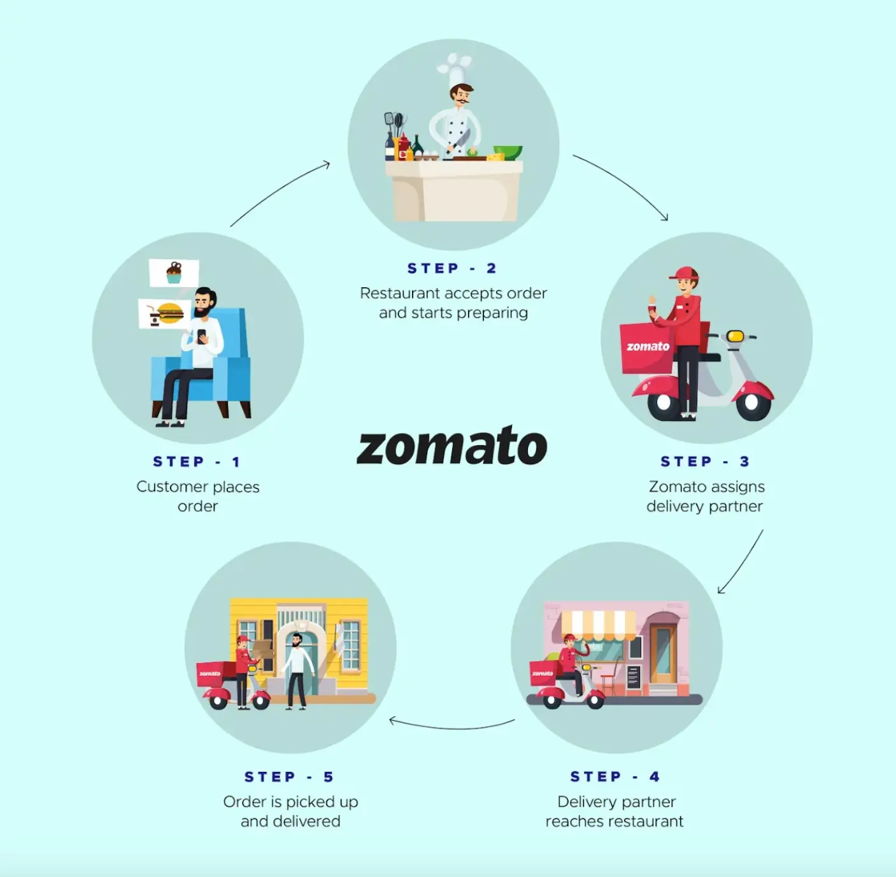
HOW ZOMATO WORKS

Slide 5

PROBLEM STATEMENT
Zomato, a leading online food delivery and restaurant discovery platform, is seeking to expand its operations and open more restaurants in various regions. As a consultant data analyst, your task is to develop strategies and suggestions for the company's expansion plans.

Slide 6
DATA OVERVIEW
RestaurantID : Unique identifier for each restaurant.
RestaurantName : Name of the restaurant.
CountryCode : Code representing the country where the restaurant is located.
CountryName : Name of the country where the restaurant is located.
City : City where the restaurant is located.
Address : Detailed address of the restaurant.
Locality : Specific locality where the restaurant is situated.
LocalityVerbose : More descriptive information about the locality.
Longitude, Latitude : Geographic coordinates of the restaurant.
Cuisines : Types of cuisines offered by the restaurant.
Currency : Currency used for pricing.
Has_Table_booking : Indicator if the restaurant offers table booking.
Has_Online_delivery : Indicator if the restaurant offers online delivery.
Is_delivering_now : Indicator if the restaurant is currently delivering.
Switch_to_order_menu : Indicator if the restaurant has a switch to order menu.
Price_range : Price range of the restaurant.
Votes : Number of votes/ratings received by the restaurant.
Average_Cost_for_two : Average cost for two people dining at the restaurant.
Rating : Rating of the restaurant.
Datekey_Opening : Date of the restaurant's opening.
Year : Extracted year from the opening date.

Slide 7

DATA PREPROCESSING
Finding Countries names : We're looking at Zomato's data to see where they're planning to open restaurants. We have a list of country codes in one sheet, and we'll use that to figure out which countries they're targeting, based on those codes, in our main data sheet.
Using VLOOKUP : To match country codes with country names, we'll use a handy Excel function called VLOOKUP. It helps us find the right country name for each country code.
Counting Restaurants by Year : We want to know how many restaurants Zomato opened each year in different countries. To do this, we'll need to pick out just the years from the dates they opened, and one way to do that is by using the LEFT() function in Excel.

Slide 8
METHODOLOGY
Data collection from the newton school portal
Data cleaning includes utilization of various functions like TRIM,CLEAN etc to ensure the data accuracy
Data enrichment includes enhancing the dataset with additional attributes like year, country names etc.
Descriptive analysis includes creating the pivot tables for analysis.
Visualization includes creation of dynamics charts and dashboard for easy analysis.

Slide 9
ANALYSIS OF ZOMATO RESTAURANT
Consists of two tables: Raw Data and Country Description. Initially 20 attributes in raw data, increased to 23 after pre-processing. Used concatenate and trim functions for consistent and cleaned data. Country Information: 4. Applied VLOOKUP to fill in country names using country codes. As we have the country code for each country in country description sheet we can use vlookup function to extract the country names for making analysis based on names.
=VLOOKUP(C2,'country description'!$A$1:$B$16,2,0)
Then I have created the pivot table that represent the number of restaurants open in each country.
Created a pivot table for the number of restaurants opened in each country. Created a pivot table for the number of restaurants opened each year. Specific Queries: 7. Found 388 restaurants in India with a price range of 4. Then I find the number of restaurants in India which has Price Range 4 using the =COUNTIFS()
function, and the counts is 388.
=COUNTIFS('Raw Data'!D:D,"India",'Raw Data'!Q:Q,"4")

Slide 10
ANALYSIS OF ZOMATO RESTAURANT
Created a pivot table for the average number of voters per restaurant in each country.
Calculated average ratings using IF, AND, and AVERAGE functions.
Highlighted rows in suggested countries/cities using conditional formatting. Created a new column with currency symbols using string operations and concatenate function.
Used COUNTIFS function to count restaurants without online delivery, in the lowest price range, and with an average cost less than or equal to 250 Indian Rupees.
Conducted market research to identify countries with less competition (Australia, Brazil, India, Sri Lanka ,United Kingdom, United States of America, New Zealand, United Arab Emirates ).
Utilized a dashboard to pinpoint suitable states and cities for restaurant openings.
suggested countries for current ratings (mostly in the 1-3 range).
Reviewed the expenditure on food in suggested countries
Competitor Analysis and Cuisine Focus: Explored competitors and lower-rated restaurants in suggested states using a dashboard.

Slide 11
ANALYSIS OF ZOMATO RESTAURANT
Analyzed current data to determine popular cuisines in specific locations.
Advised on the importance of online delivery and table booking, impacting customer ratings positively.
Recommended keeping cuisine rates higher, as it does not significantly affect feedback. Visualized the distribution of restaurants in different price ranges across all countries.
Suggestion Approach: Recommended an approach for suggesting countries/cities, emphasizing global competition research, customer feedback analysis, consideration of economic factors, visualizations for clarity, and prioritization of countries with lower competition and positive feedback.

Slide 12
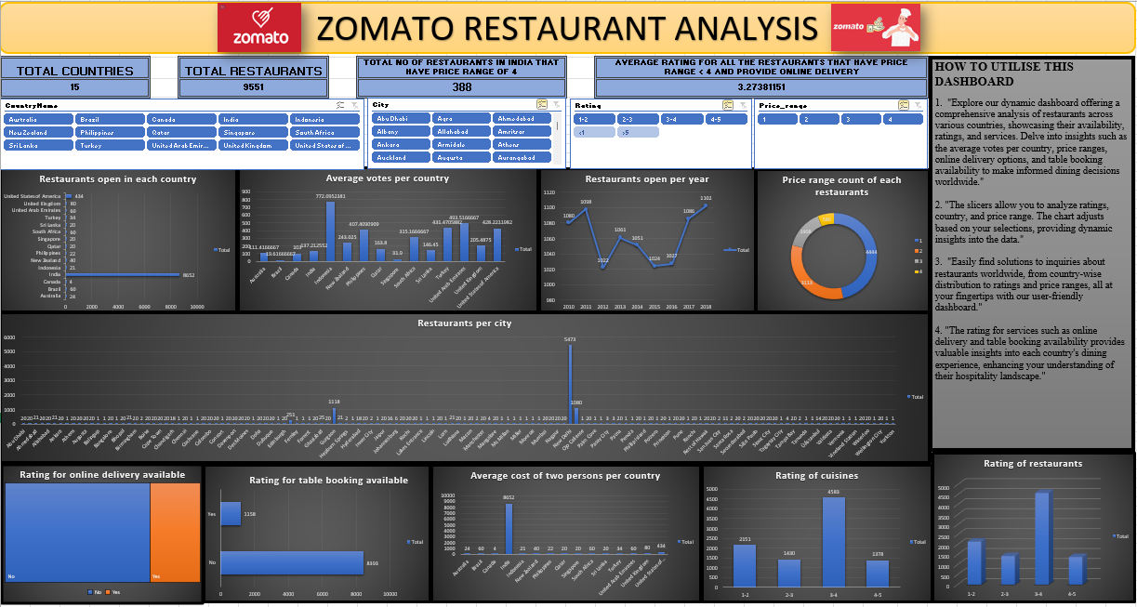
DASHBORAD

Slide 13
HOW TO USE THE DASHBOARD
1. "Explore our dynamic dashboard offering a comprehensive analysis of restaurants across various countries, showcasing their availability, ratings, and services. Delve into insights such as the average votes per country, price ranges, online delivery options, and table booking availability to make informed dining decisions worldwide."
2. "The slicers allow you to analyze ratings, country, and price range. The chart adjusts based on your selections, providing dynamic insights into the data."
3. "Easily find solutions to inquiries about restaurants worldwide, from country-wise distribution to ratings and price ranges, all at your fingertips with our user-friendly dashboard."
4. "The rating for services such as online delivery and table booking availability provides valuable insights into each country's dining experience, enhancing your understanding of their hospitality landscape.

Slide 14
CONCLUSION
In wrapping up, our strategy for choosing countries and cities to open new restaurants is all about thorough analysis and smart decision-making. We look at things like how many other restaurants are around, what customers think, and economic factors. Visualizing all this data helps us see the big picture.
But it's not just about numbers – we also consider local vibes, rules, and what people like to eat. We listen to local experts and think about things like roads and how easy it is to get to our restaurants. We want to make sure our restaurants are not just popular now, but stay that way in the long run.
By putting all these pieces together, we're confident we can find the perfect spots for our new restaurants. It's not just about today – it's about building a lasting presence in the restaurant world.

